Slide 1
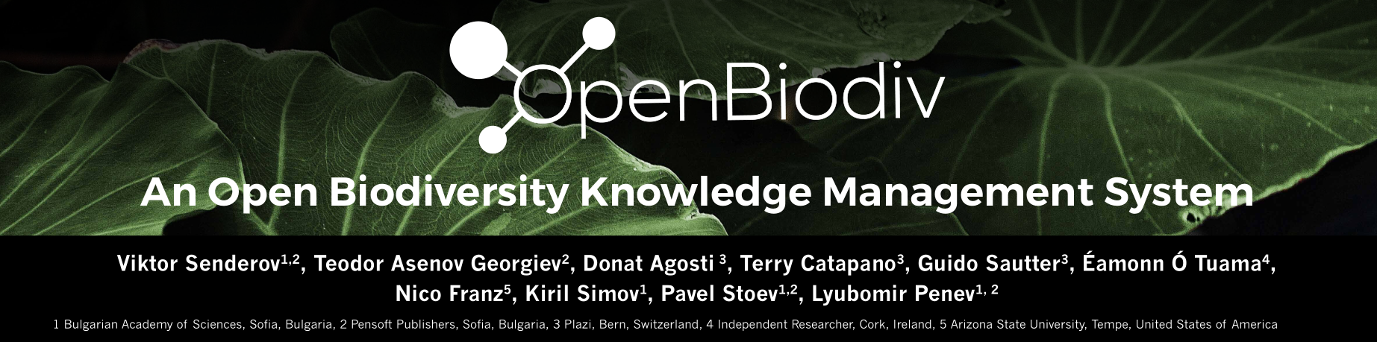



An Implementation of a Semantic System Running on top of the Biodiversity Knowledge Graph
Notes:
Good morning, TDWG, it is an honor to be here to the second time presenting the pilot of OpenBiodiv. My name is Viktor Senderov and I am part of Pensoft – student of Prof. Penev – who unfortunately cannot make it due to unexpected circumstances – and part of Marie-Curie’s BIG4 International Training Network in bioinformatics of insects. OpenBiodiv is also brought to you via Plazi, the swiss based “freedom fighter” if I may say so, who have so far open-sourced more than 100,000 articles in biodiversity.

Slide 2
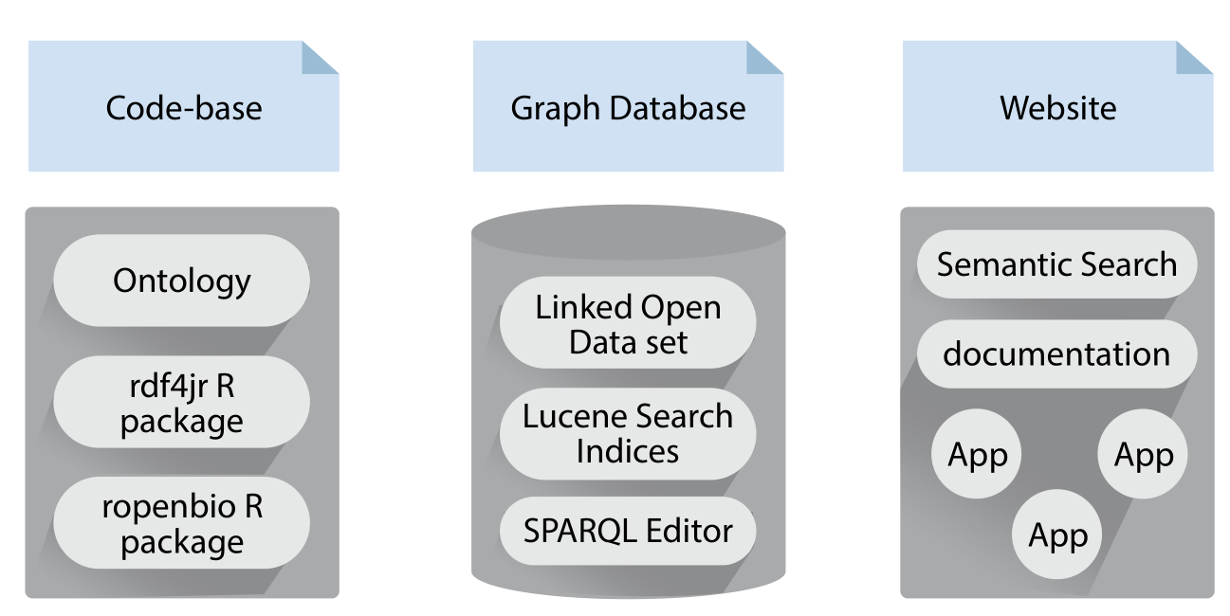
What is OpenBiodiv?
Notes:
OpenBiodiv is not one thing. In fact we use the name to refer to three distinct entities. Above everything else, OpenBiodiv is a semantic graph database. The database contains the LOD dataset but is a little bit more – it hosts a Lucene Search index, an API, a workbench with a SPARQL editor – all available to its users. To create the dataset/database we wrote own R libraries for RDF-ization and our own ontology – more about them later. While these two components were already present in a rudimentary form during last year’s TDWG, this year we also want to present to you the beta version of the website developed at Pensoft.

Slide 3
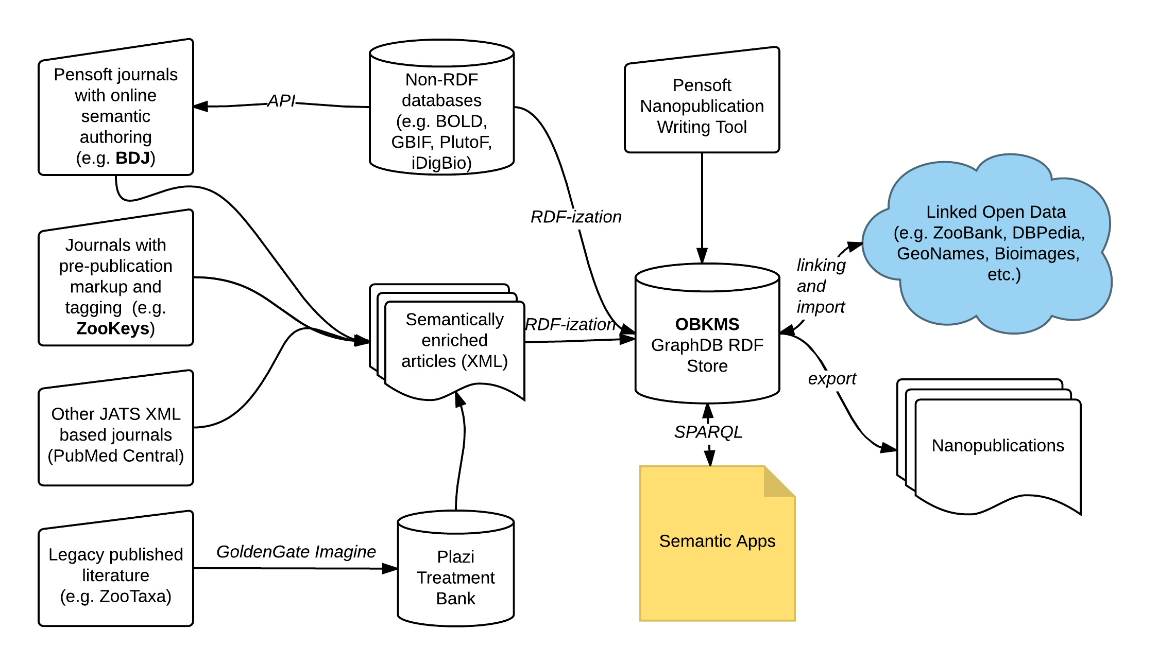
Where is data obtained from?
Notes:
This graph is something that I showed during last year’s presentation so some of you might be familiar with it. It roughly outlines where the data for OpenBiodiv comes from and where it goes. The core of the system is information extracted from Pensoft’s multiple taxonomic journals (TaxPub XML) and Plazi’s digitized legacy literature. After knowledge is extracted it is then linked to (for now) DBPedia and aggregators such as ZooBank, but will soon be linked to GeoNames, GBIF, and possibly BioImages.

Slide 4
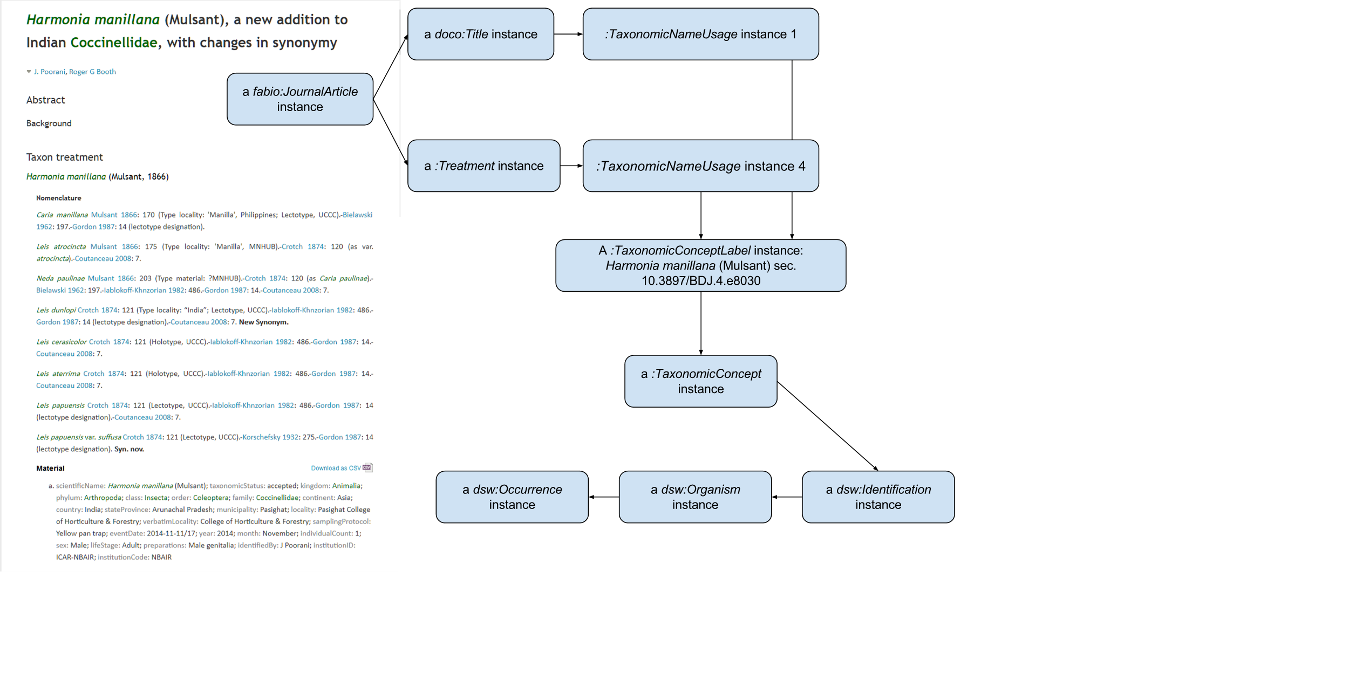
What do we want?
Notes:
But how is knowledge extracted from literature? For this we need a data model – in our case RDF – and an ontology (i.e. axioms on how to apply the data model). In this slide, I outline how prominent components of a biodiversity publication are turned into graphical representation utilizing our ontology. EXPLAIN THE GRAPH

Slide 5
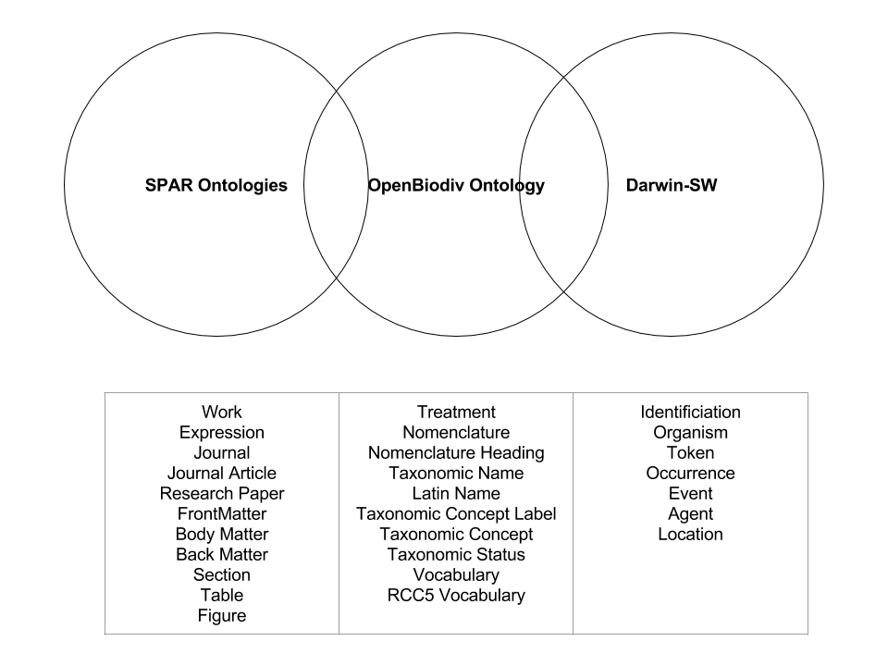
OpenBiodiv Ontology
Notes:
The OpenBiodiv ontology that we are currently resubmitting to one of the top semantic web journals is an ontology that links the publishing domain with the biodiversity domain. The OpenBiodiv system uses the Semantic Publishing and Referencing Ontologies (SPAR) to model entities such Journal, Article, Section, Figure, Table and so on. SPAR also gives us ways to deal with dichotomy between the abstract representation of knowledge through the class Work (e.g. paper) and its concrete repreresenation through the class Expression (e.g. article).
On the other side, we’ve got Darwin-Semantic Web due to Baskauf and Webb -- respected members of our TDWG community – that brings the Darwin Core terms to the semantic web by creaing classes for Identification, Organism, Token, and so on.
OpenBiodiv overlaps with both – it introduces some classes and properties that might be considered publishing-related, and some that might be considered taxonomic – it thus serves as a missing link. Of course, it doesn’t come out of the blue and is based on previous efforts such as the Treatment ontology – due to Catapano and Morris – and TDWG’s Taxonomic Concept Transfer Schema, to name a few. It introduces classes (and properties) for READ OUT ALOUD

Slide 6
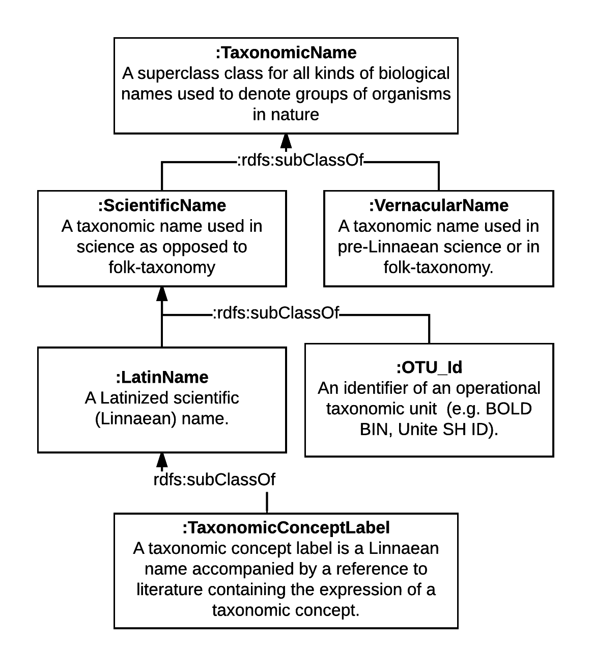
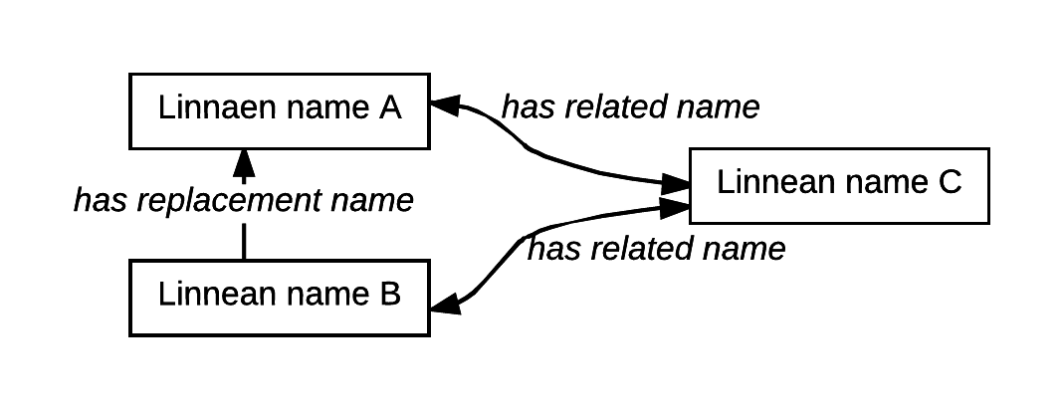
How are names treated?
~ NOMEN biological name
~ NOMEN scientific name, NOMEN vernacular name
Notes:
Taxonomic Names are treated prominently in the OpenBiodiv Ontology. On this slide you see the class hierarchy of taxonomic names and its alignment to NOMEN (an ontology of taxonomic names due to Dmitriev and Yoder). Important extensions here, not found in NOMEN, is the creation of the class Taxonomic Concept Label as a subclass of Latin Name, and the class OTU_id as subclass of scientific name. This classes were added with the hope that the ontology will help bring into one database tradional Linnaen names and gnomically. delimited OTU’s.
In the lower right corner of the slide you see the relationships that we’ve given to names. Notably absent are hierarchical relationships – these have been moved to the class taxonomic concept. Instead we have the bidirectional transitive symmetric relation “replacement name” to denote a degree of semantic relatenedness (not necessarily similarity!) between the terms, and the unidirectional “has replacement name” to denote the nomenclatural process of deprecating a taxonomic name.

Slide 7
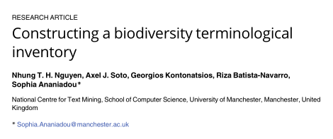
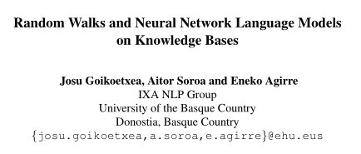
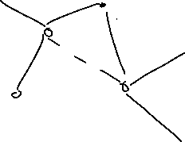
Related names
“Extraterrestrial”
“Aus aus”
“Europa”
“Aus bus”
Vector Representation
Aus aus 𝛼 (e.g. “11100111…”)
Aus bus 𝛽
Aus aus is related to Aus bus ⬄
cos∢(𝛼, 𝛽) > d
d ∈ [0,1]
“Europa Aus aus extraterrestrial Aus bus.”
Notes:
This related names relationship is also central to the work of the symposium coorganizers whose paper I am showing in the upper left corner of the slide. Nguyen et al. use Distribitional Semantic Models to infer a vector representation of taxomic names. Then they infer that two names are related iff the cosine of the angle between the formed vectors is close to one. One would mean that the vectors are colinear, if high-school trigonometry still serves me well.
On the other hand, in our knowledge base, the relationship is explicit – it is either there or not – and it is there if the names have been mentioned together in the nomenclatural citation list. In other words we simply extract the human-curated knowledge and do not impose on it further knowledge inferred by the machine. As humans are error prone, and before all, as bags of water tire very fast – this knowledge is incomplete – and may be extended by simply “lifting” the inferred information into the graph.
There is, however, another ansatz to reconcile the two approaches that I would love to discuss with you in the QA section. Namely, it is possible to “drop” the graph as pseudo-text that can then be used the DSM algorithm in addition to the article text via a random-walk procedure. It is interesting whether such step will further improve the relatedness benchmarks used by Nguyen et al.

Slide 8
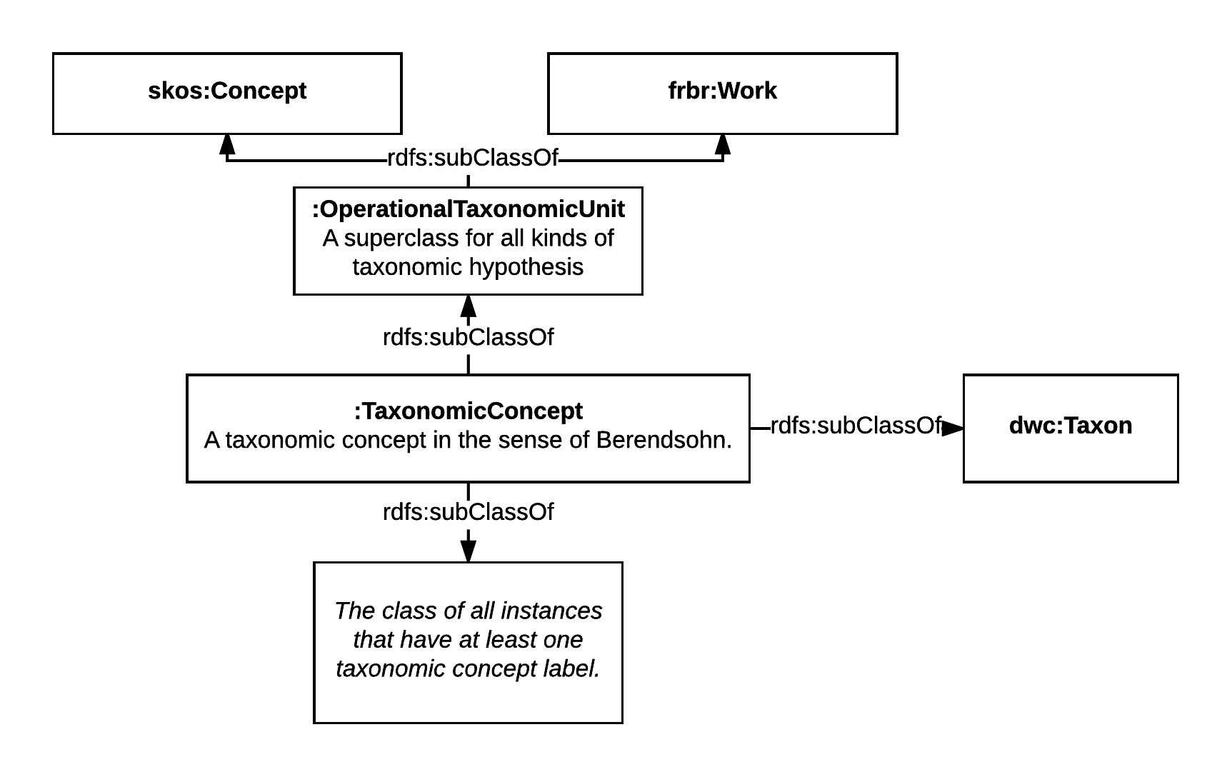
How are taxonomic concepts treated?
Notes:
Now we come to taxonomic concepts. This graph shows the allighment of OpenBiodiv’s taxonomic concept class to SKOS and FRBR. We treated as a specialization of DwC’taxon. One requirement that we place on taxonomic concepts is for them to have taxonomic concept labels.

Slide 9
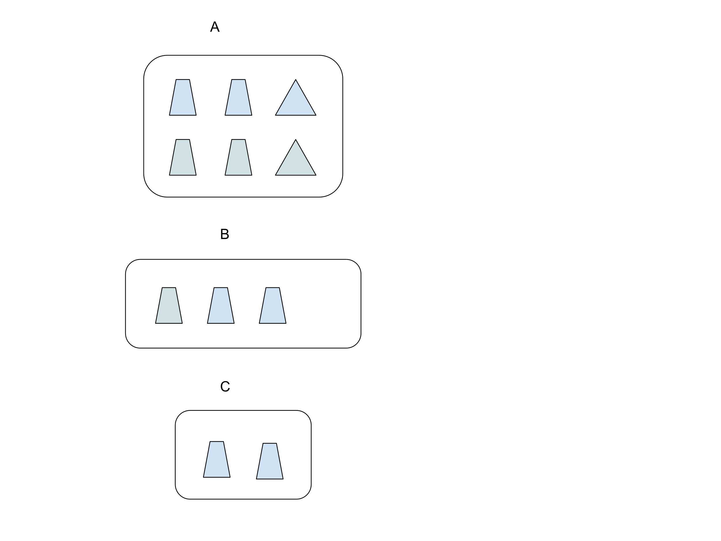
We don’t have а single backbone taxonomy!
Relation 1:
from: B
to: A
type: proper part
according to: (nano)publication 1
Relation 2:
from: C
to: B
type: proper part
according to: (nano)publication 2
Backbone 1:
has: publication 1
has: publication 2
A <- B <- C
Relation 3:
from: C
to: A
type: proper part
according to: (nano)publication 3
Relation 4:
from: C
to: B
type: equal
according to: (nano)publication 4
Backbone 2:
has: publication 4
has: publication 4
A <- B = C
Notes:
By separating taxonomic concepts from taxonomic names we can have multiple “backbone” taxonomies in our graph. On the example shown in this slide we have three taxonomic concepts: A, B, and C, and four papers: publication 1, 2, 3, and 4, that asserts statements about these three concepts.
On the one hand, publication 1 claims that B is a proper part of A, and publication 2 claims that C is a proper part B. Thus, Backbone 1, made up of pubs 1 and 2 creates the taxonomy A <- B <- C.
On the other hand, publication 3 asserts that C is a proper part of A (so far we have no conflict with the first backbone); however, it claims that B and C are equal taxonomically. The small variation in color does not warrant a new taxonomic concept according to publication 4. Thus backbone 2 asserts a different taxonomy A <- B = C that can coexist with the first one in the graph.

Slide 10
RDF-ization
Data gathering
Extraction
Serialization
Submission to the database
Notes:
I know want to shift the focus to the process of RDF-ization accomplished by our R packages. My definition of RDF-ization is perhaps somewhat narrower that others, as I only discuss here the lifting of information already in a semi-structured format (i.e. XML, or CSV) to RDF.
The process entails 4 steps: READ AND COMMENT THE STEPS

Slide 11
Extraction
XML Document (node) → RDF (Turtle)
Complexity reduction
Object construction:
Atom extraction
Lookup of identifiers (including external identifiers)
RDF-ization
RDF-ization of individual object
“Connect” all of the objects that the extractor has created via appropriate predicates
Notes:
I want to further discuss the process of Extraction (accomplished by Extractor functions in our framework).
XML is broken up into components (XML nodes) corresponding to parts of the paper (such as Title, Abstract, Figure, etc.)
Individual components are used to construct objects in memory corresponding to class instances in the data model
Atom extraction: individual atom locations (e.g. XPATH) are read to get the Literals and URI’s that will be the subjects in our triples
Disambiguation step: the database is queried to see if it contains an entity for the object. If yes, then its ID is returned. If no, then a new one generation
RDF-ization step: the objects are represented as RDF
There are functions that know how to convert indidual objects to RDF
On top of that, the extractors now how to link them together.
It is important to note here that one component may create several objects. E.g. a TaxonomicNameUsage component creates both a TaxonomicNameUsage object and a TaxonomicName object. A Treatment component creates both a Treatment and a TaxonomicConcept object. Finally, Everything is packaged and submitted to the server.

Slide 12
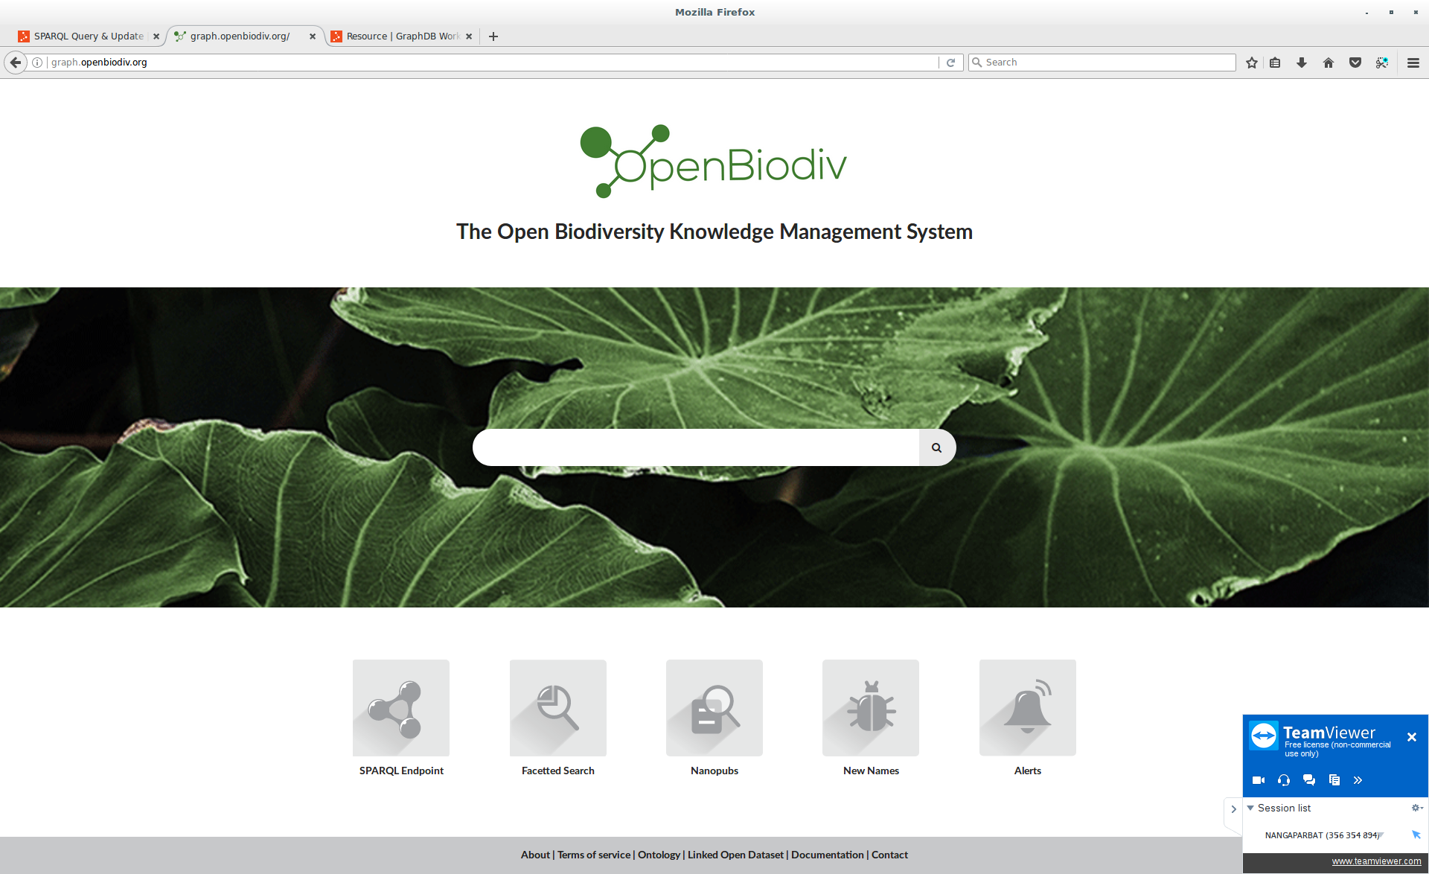

Notes:
Enough theoretical talk! The system is now on-line for all to test as a beta-release under openbiodiv.net!!
It’s main window features a semantic search interface as well access to various apps. The semantic search interface operates intuitively allowing you to browse the graph database based on the templates that we’ve created for key datatypes without the need to write SPARQL.

Slide 13
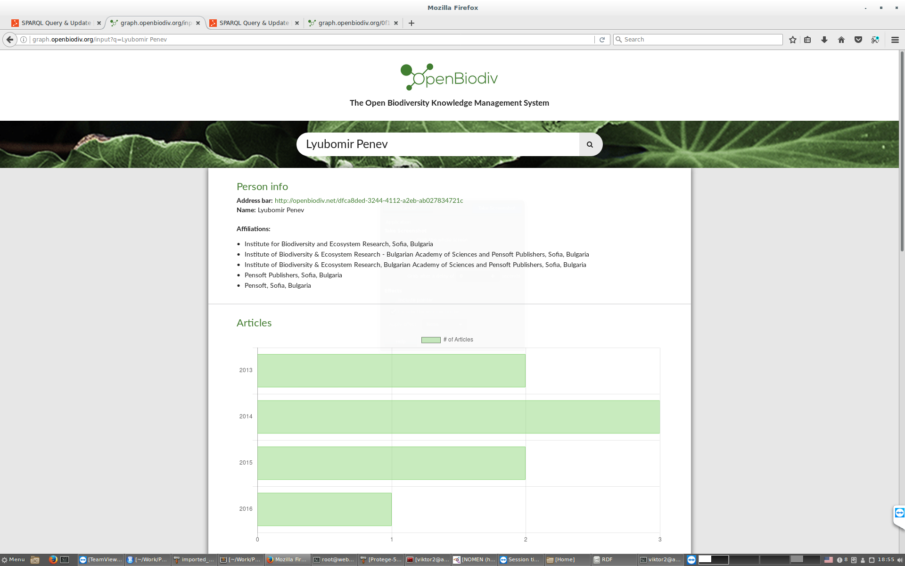
Notes:
For example, here I’ve typed the term Lyubomir Penev and the system has correctly identified it as a Person and invoked the Person template, giving me general information about the person as well as person statistics. From here I can also browse the top collaborators of this person and see their statistics.

Slide 14
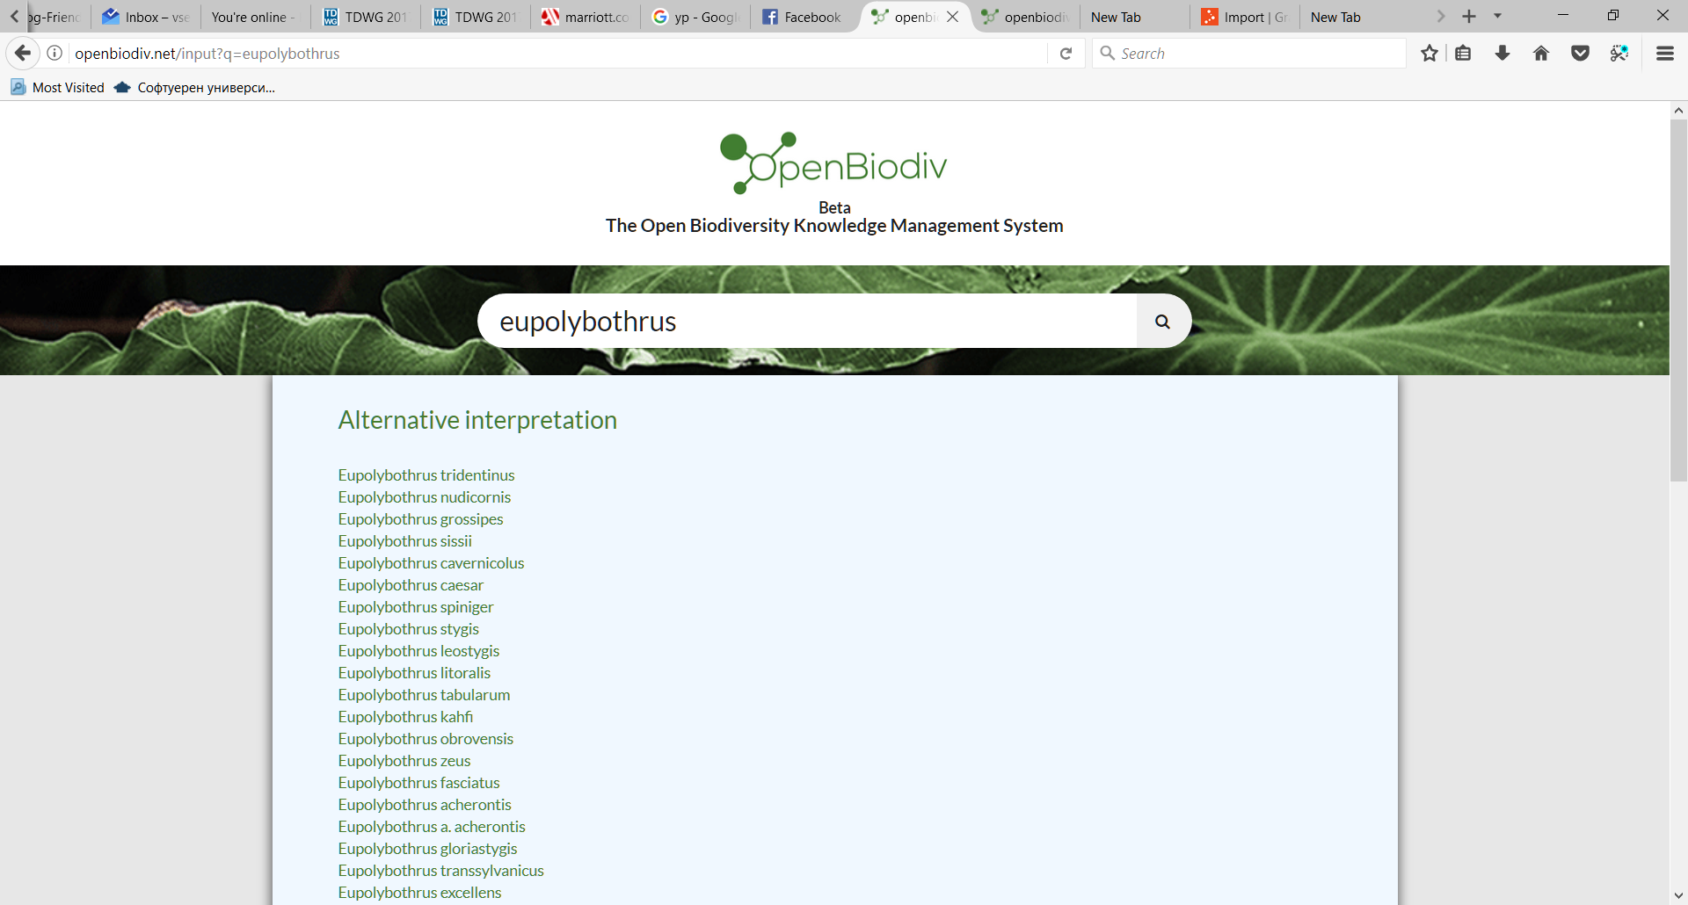

Slide 15
Please give us your app ideas!
Financed through the European Union’s Horizon 2020 research and innovation program under the Marie Sklodovska-Curie grant agreement No. 642241.
Thank you

